Slide 1
Formal Methods

Slide 2
Contents
What are Formal Methods?
  Definition
  Myths
  History
  Types of formal methods
  Use of mathematics
Do we really need Formal Methods?
  Design errors
  Effects of design errors
  The promise of formal methods
The Formal Methods Debate
  General concerns
  Weaknesses in formal methods
  Success of formal methods

Slide 3
What Are Formal Methods
Formal methods refers to a variety of mathematical modeling techniques that are applicable to computer system design.
They include activities such as system specification, specification analysis and proof, transformational development, and program verification.

Slide 4
Definition
“ Formal methods are mathematical approaches to software and system development which support the rigorous specification, design and verification of computer systems.” ^{[Fme04]}
“[they]… exploit the power of mathematical notation and mathematical proofs. “ ^{[Gla04]}
Notes:
The phrase "mathematically rigorous" means that the specifications used in formal methods are well-formed statements in a mathematical logic and that the formal verifications are rigorous deductions in that logic (i.e. each step follows from a rule of inference and hence can be checked by a mechanical process.)

Slide 5
Seven Myths of Formal Methods
Formal methods can guarantee that software is perfect.
Work by proving that programs are correct.
Only highly critical systems benefit from their use.
They involve complex math.
They increase the cost of development.
They are incomprehensible to clients.
Nobody uses them for real projects.

Slide 6
History
Formal specifications have been in use since the early days of computing.
  1940's: Turing annotated the properties of program states to simplify the logical analysis of sequential programs.
  1960's: Floyd, Hoare and Naur recommended using axiomatic techniques to prove programs meet their specifications.
  1970's: Dijkstra used formal calculus to aid to develop of non-deterministic programs.
The interest in the use of formal methods in software engineering has continued to grow.

Slide 7
Definition
"Formal is often confused with precise".
A formal specification consists of three components:
  Syntax - grammatical rules to determine if sentences are well formed
  Semantics - rules for interpreting the sentences in a precise, meaningful way within the domain
  Proof Theory - rules for inferring useful information from the specification

Slide 8
What are Formal Methods?
Notation with precise syntax and semantics
Doesn’t necessarily involve mathematics
Although mathematics is a formal notation
There are levels of formulization.
  Techniques, methods, procedures, tools can support levels

Slide 9
Types of Formal Methods
A variety of formal methods exist:
  Abstract State Machines - The Abstract State Machine (ASM) thesis implies that any algorithm can be modeled by an appropriate ASM.
        http://www.eecs.umich.edu/gasm/
  B-Method - B is a formal method for the development of program code from a specification in the Abstract Machine Notation.
        http://www.afm.sbu.ac.uk/b/
  Z – A specification language used for describing computer-based systems; based set theory and first order predicate logic
  http://vl.zuser.org/
  “Unified Modeling Language (UML) provides system architects…with one consistent language for specifying, visualizing, constructing, and documenting the artifacts of software systems..”
    Visual notation for OO modeling
    Extensible
    Independent of programming languages
    Formal basis for understanding the modeling language

Slide 10
Other Types of Formal Methods
Others types include:
  CommUnity
  Estelle
  Esterel
  Lotos
  Overture Modeling Language
  Petri Nets
  RAISE
  SDL
  TRIO, Unity, and VDM
  Any programming language

Slide 11
Predicate Calculus
The first order predicate calculus is a formal language for expressing propositions.
A properly-formed predicate calculus expression is called a well-formed formula or WFF (pronounced wiff).

Slide 12
Predicate Calculus
Constant
Variable
Predicate
Function
Connective
Quantifier

Slide 13
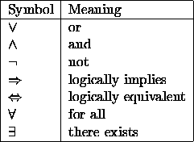
Predicate Calculus

Slide 14
Predicate Calculus
Whoever can read is literate.
Dogs are not literate.
Some dogs are intelligent.
Some who are intelligent cannot read.
1. ∀x [R(x) ⇒L(x)]
2. ∀x [D(x) ⇒¬R(x)]
3. ∃x [D(x) ∧ I(x)]
4. ∃x [I(x) ∧¬ R(x)]

Slide 15
Levels of Rigor
Specifications, models, and verifications may be done using a variety of techniques.
Level 1 represents the use of mathematical logic to specify the system.
Level 2 uses pencil-and-paper proofs.
Level 3 is the most rigorous application of formal methods.

Slide 16
Do we really need Formal Methods?
Design errors
"Digital systems can fail in catastrophic ways leading to death or tremendous financial loss.“ ^{[Nas03]}
Potential causes of failure include:
  physical failure
  human error
  environmental factors
  design errors
- Design errors are the major culprit.

Slide 17
Effects of Design Errors
Between June 1985 and January 1987, a computer-controlled radiation therapy machine, called the Therac-25 , massively overdosed six people, killing two.
On April 30, 1999 Titan I cost taxpayers 1.23-billion dollars, all due to a software malfunction (incorrectly entered roll rate filter constant)

Slide 18
Effects of Design Errors
Denver Airport’s computerized baggage handling system delayed opening by 16 months. Airport cost was $3.2 billion over budget.
NASA’s Checkout Launch and Control System (CLCS) cancelled 9/2002 after spending over $300 million.

Slide 19
The promise of Formal Methods
Formal methods are needed to:
  Improve SW Quality
  Reduce cost of verifying system
  Improve quality and rigor of entire development process
  Reduce specification errors and provide a rational basis for choosing test data
  Explore the properties of a design architecture
Notes:
“Software becomes the Achilles' heel of almost any aerospace defense project. To get it wrong means the whole project may go down the tubes.” [Hug97]
[Hug98] D. Hughes, AVIATION WEEK & SPACE TECHNOLOGY, December 21/28, 1998.
Reasons we need new methods of verifying SW systems:
- Guarantee SW Quality
Traditional methods (human inspection, simulation, and testing) cannot guarantee SW quality. Human inspection limited by capabilities of reviews simulation and testing on explore a small faction of "state space of any real SW system."
- Reduce cost of verifying system
Verifying systems are expensive. It is not unusual to hear that 60% or 70% of the cost of an avionics box is verification and certification cost.
- Failure of Redundancy techniques
Redundancy techniques used for hardware fault-tolerance do not work for the design error problem.
- Improve quality and rigor of whole development process
- To reduce specification errors and provide a rational basis for choosing test data
- To explore the properties of a design architecture
In some applications it is not possible to characterize the behavior of the context of the software; n some telecommunications environments, for example, patterns of traffic may be to an extent unpredictable. [Fme04]

Slide 20
The Formal Methods Debate: General Concerns
Evidence
  No Quantitative evidence
  Used with other techniques formal methods has led to highly reliable code; fewer errors and easy to test.
  "Formal methods do not claim to remove the possibility of unwise design decisions.“ ^{[San98]}
Impracticality
  "Automatically generating proofs of program correctness are regarded as unrealizable for realistic systems."
  Methods of automatically generating test cases that expose problems are available.
Communication
  Improved documentation and better understanding of designs
  Difficult for untrained SW Eng/Consumer to understand specs.

Slide 21
Weaknesses in Formal Methods
Weaknesses:
  Low-level ontologies
  Limited Scope
  Isolation
  Cost
  Poor tool feedback
Notes:
The inadequacy of formal methods for critical upstream requirements specification and analysis are a result of these weakness:
Low-level ontologies
most often program concepts (mostly data and operations) are structured and formalized. There needs to a higher level of abstraction and conceptual richness found in informal requirement documents.
Limited Scope:
Vast majority of techniques limited to the specification of functional
properties of the target system.
Isolation:
Formal specifications are isolation form other SW products and process.
Cost:
There is a scarcity of expertise in informal system in general and mathematic logic in practice.
Poor tool feedback:
Tools identity error, but do give the root of the problem or propose a solution.
------------------------------------------------------------------------------------------
In computer science, an ontology is the attempt to formulate an exhaustive and rigorous conceptual schema within a given domain, a typically hierarchical data structure containing all the relevant entities and their relationships and rules (theorems, regulations) within that domain. The computer science usage of the term ontology is derived from the much older usage of the term in philosophy, where it means the study of being or existence as well as the basic categories thereof.
------------------------------------------------------------------------------------------

Slide 22
Success of Formal Methods
There are many examples of successful and cost-effective systems implemented using formal methods.
  Mainly in domain of transportation systems
  Also in domains such as:
    information systems
    telecommunication systems
    power plant control
    security

Slide 23
Investigating Influence of Formal Methods: Case Study
Project: Praxis air-traffic control information system for UK Civil Aviation Authority
  Used FMs before, not to this extent
  Developed functional requirements using 3 techniques:
    E-R analysis
    Real time extension of Yourdon-Constantine structured analysis
    Formal Methods for specification and Design

Slide 24
Use of Formal Methods
Application Code:
  specification language to define data and operations (VDM –Vienna Development Method)
Concurrency
  FSM to define concurrency and invoke app code
LAN
  Mix of BDM and CCS (Calculus of communicating sequential processes)
  Formal proofs
User Interface Code - pseudocode

Slide 25
Data
Quality in terms of faults and failures – normalized by size (LOC)
Reliability – MTTF
Assigned severity to failure reports (1-3)
Documents and modules changed listed
Partitioned data – problems arising from code vs. spec/design
Classified modules by type of design that influenced it

Slide 26
Questions
Did formal methods quantitatively affect code quality?
Was one formal method superior to another?
Answers:
  Quantitative evidence of high code quality
  Changes to informally designed modules not significantly different
  Fewer VDM/CCS modules changed overall
  Code developed using VDM alone required most changes
  Formally designed modules with fewer developers had fewer faults
  Overall significance between informal and formal methods is insignificant
  Differences may have nothing to do with design method, but reflect those who use them: Quality was lower in larger groups developing code together.

Slide 27
Lessons Learned
No evident formal design techniques alone produced higher quality code
Formal design with other techniques yielded highly reliable code
Formal specification and design effective in some, but not all circumstances
Formal specification led to simple, independent components and straightforward unit testing
Formal methods may be more effective acting as a catalyst for other techniques, such as testing

Slide 28
Success of Formal Methods
The following (abridged) list applications made using of formal methods:
  Ammunition Control System
  Architecture for a Family of Oscilloscopes
  B27 Traffic Control System
  Cancan Mediation Device
  Car Overtaking Protocol
  Control Logic Design of Robot Work Cells
  Data Acquisition, Monitoring and Commanding of Space Equipment
  Data logger for an implantable medical device
  ELSA (control system of a power plant)

Slide 29
Why aren’t formal methods widely used?
Software quality has improved
Time-to-market more important
User interfaces are a greater part of systems
Formal methods have limited scalability

Slide 30
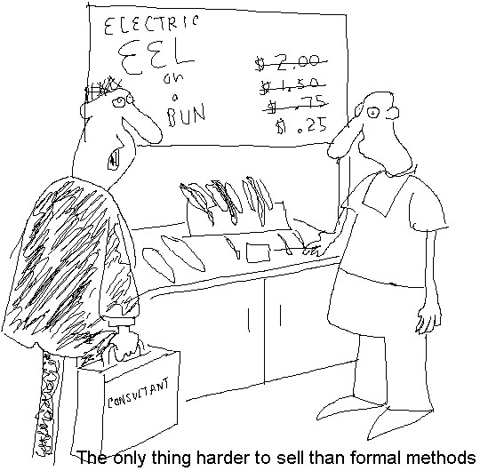
Formal Methods Humor???

Slide 31
What needs to be done to make “formal methods” industrial strength?
Bridge gap between real world and mathematics
Mapping from formal specifications to code (preferably automated)
Patterns identified
Level of abstraction should be supported
Tools needed to hide complexity of formalism
Provide visualization of specifications
Certain activities not yet ‘formulizable’ methods
No one model has been identified which should be used for software
Focus on WHY we use techniques and sell to managers

Slide 32
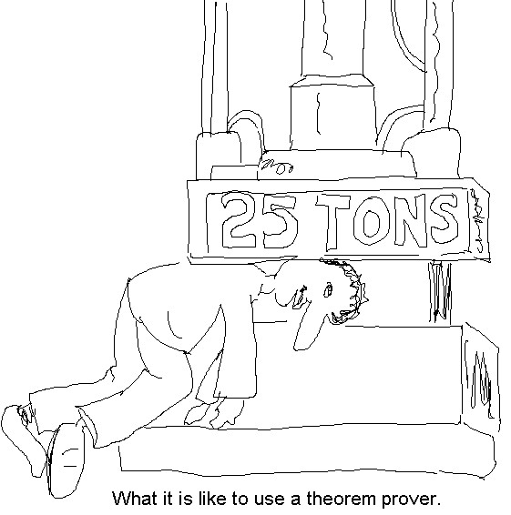
Formal Methods Humor???

